Slide 1
Chest X-Ray Classification
Dornala Venkata Satya Sai Srikar (19BCE1237)
Melacheruvu Rohan Reddy(19BCE1191)
Kasireddy Ramacharan Reddy(19BCE1365)

Slide 2
Abstract
Medical Sciences has progressed much in day to day, chest radiology requires timely reporting, fast detection of various diseases. Automating this is a crucial step in radiology. In this paper we have developed a CNN for classifying chest X-ray images into 15 different categories. The dataset comprised of TFR records which had over 112120 compressed chest X-rays present in them.
The performance of our developed model along with the highlighting of gradients shows that automation has a lot to offer to improve the quality of our medical infrastructure and patient care overall, in general

Slide 3
Introduction
Cardiothoracic and pulmonary abnormalities are one of the leading causes of morbidity, mortality, and health service use worldwide. American Lung Association says that, lung cancer is the number one cancer killer in the United States, with more than 33 million Americans have a chronic lung disease. The chest radiograph (chest X-ray) is the most commonly requested radiological examination owing to its effectiveness in the characterization and detection of cardiothoracic and pulmonary abnormalities. It is also widely used in lung cancer prevention and screening. Due to the heavy workload of doctors and radiologists timely, the reporting and examination of chest X-ray takes a lot of time and , this in some cases can mean deadly consequences for the patient, in this sense an automated model , which is able to classify various chest ray images into a broad range of categories is indeed , going to be a useful resource , as it can help our medical professionals make an informed decision more quickly. The time saved by our medical professionals an now be spent on images or a set of images (X-rays) which the model, doesn’t perform well on, these images can now be used to further increase the performance of the model
Deep learning which is commonly known as DL, is a new and emerging subfield of Machine learning. These algorithms take their inspiration from the workings of the human brain. Deep learning nowadays is the leading method used to create Artificially intelligent machines which are capable of replicating human intelligence. Deep learning models are used in Computer vision, Natural language processing and many other complicated applications such as automated driving etc.
Deep learning models such as CNNs have proven to be an extremely important tool to perform computer vision, due to the information age bought by internet has led to the emergence of large-scale datasets. CNNs take processed images as input and perform a series operation to learn rich information about the image, in order to bridge the gap between high-level representation and low-level features.

Slide 4
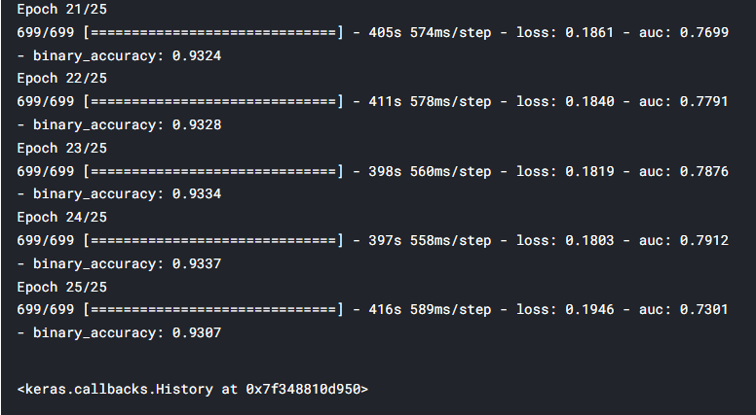
Model training

Slide 5
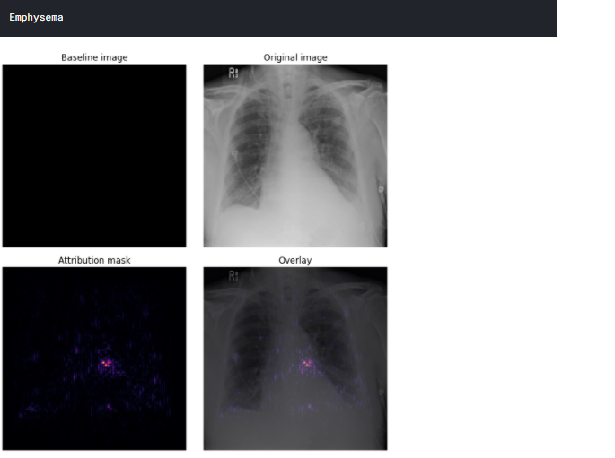
Output from a single chest X-ray

